Slide 1
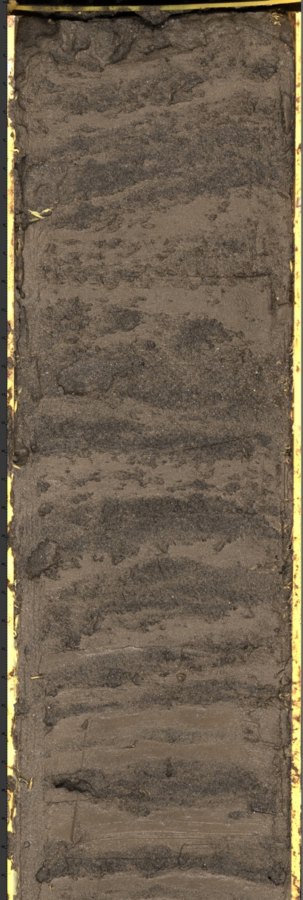
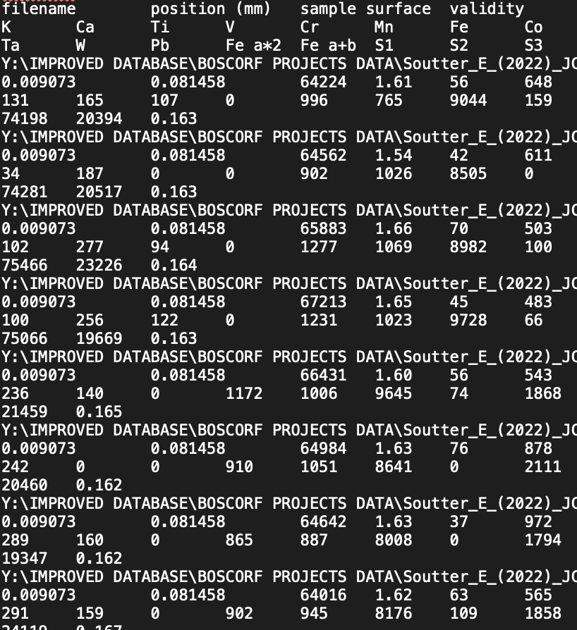

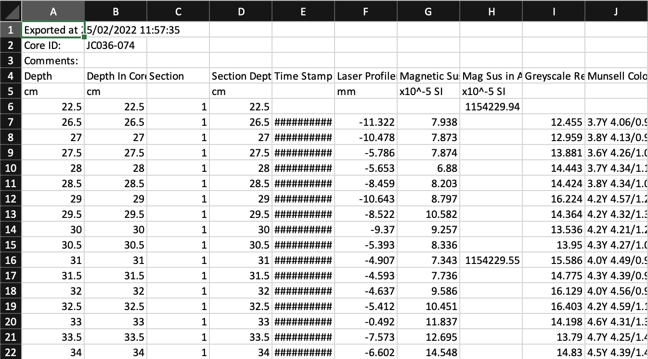

Data Integration with Python
+

Slide 2
Scope and Plan
Quick intro to Python from a fellow geologist…
Primary aims are that by the end you will: 1) see how useful Python could be for your own work, and 2) want to learn more
There are four notebooks with exercises:
Basics: 50 mins + 10 min break
Libraries and modules: 50 mins + 10 min break
Field example: 50 mins + 10 min break
ADV example: optional
GIS/Lime example: optional
Install: optional
The Binder links will be open permanently so feel free to leave and come back to the notebooks and exercises whenever you want
There is also a guide for downloading Python to your own machine and some ‘cheatsheets’

Slide 3
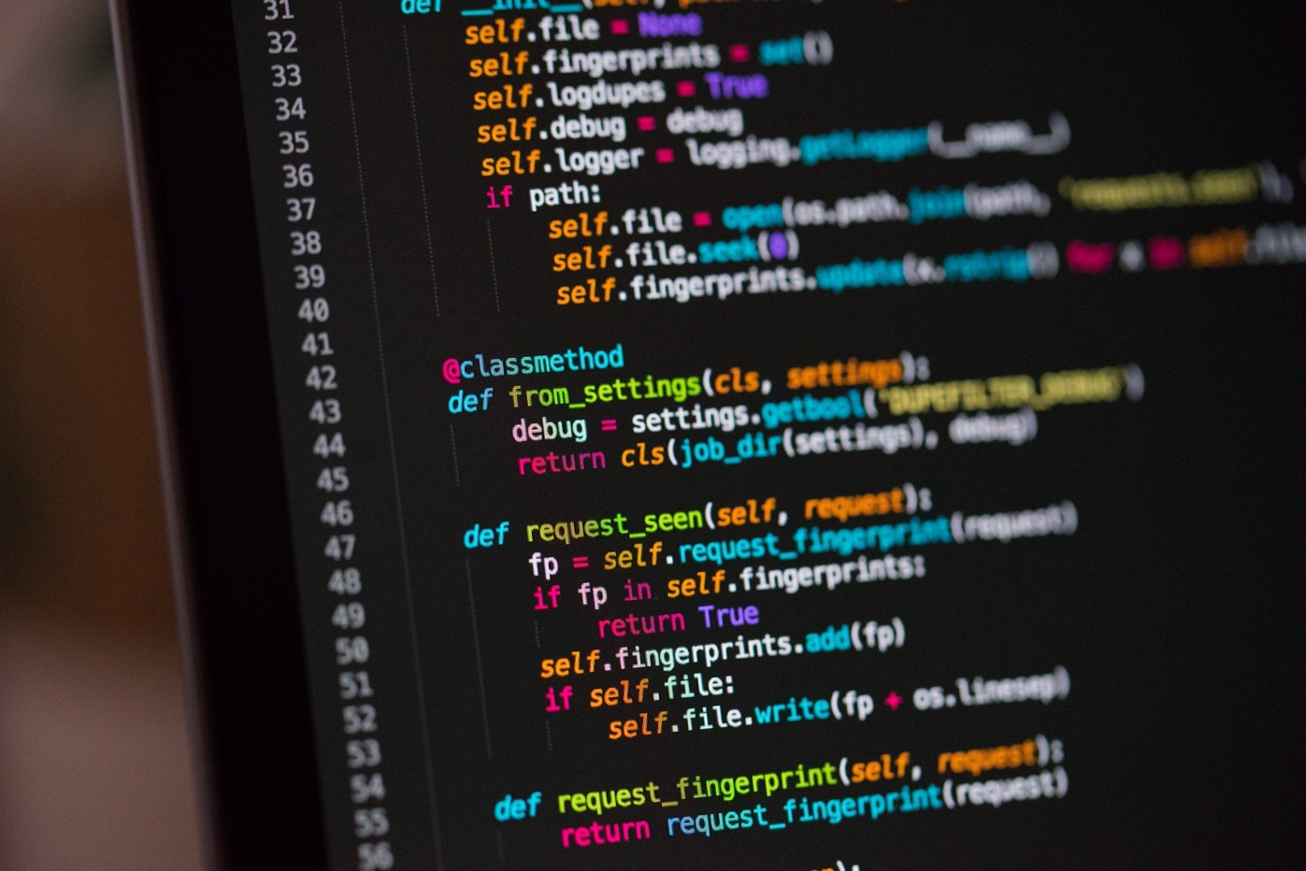





What is Python?
Programming language released in 1991
Named after Monty Python
Most popular language in the world, ahead of C and Java (Sept. 2022)
Builds many websites and software
e.g. Netflix, Instagram, Facebook
Used heavily across science and engineering
Free, readable, big community

Slide 4
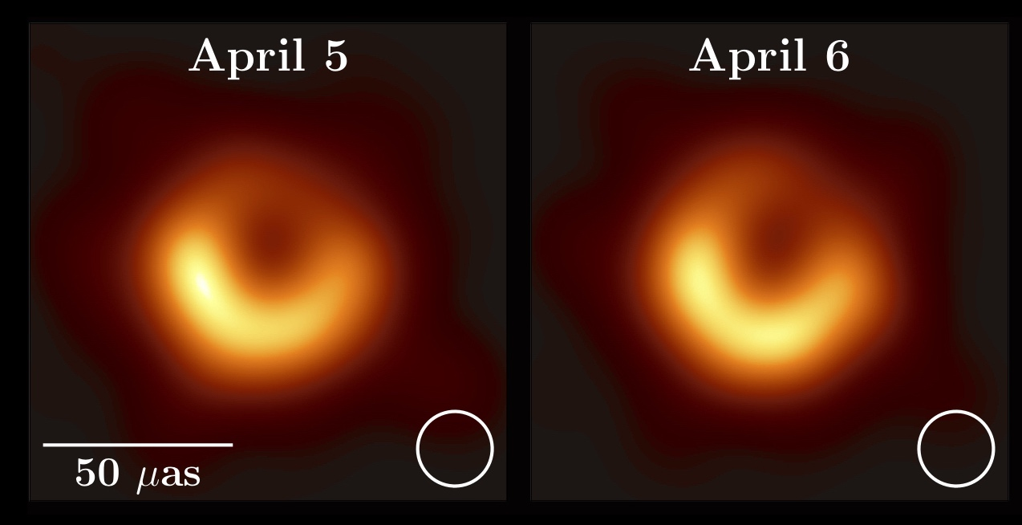
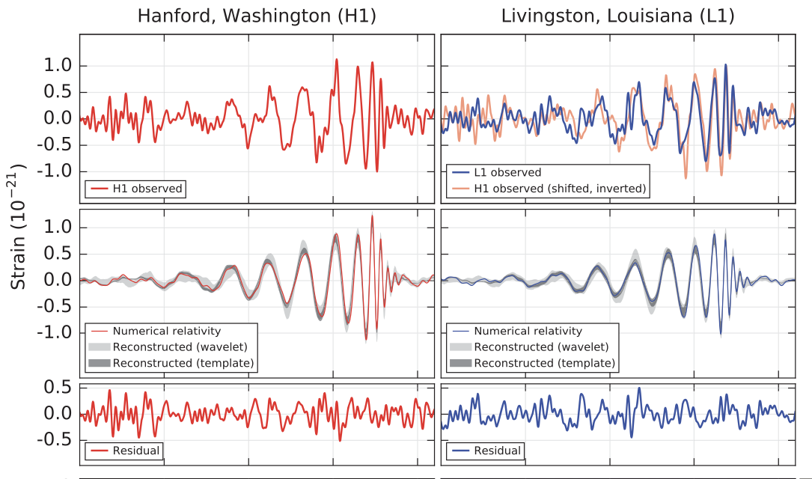
Python in science
Used to image the first black hole…
and the code is available here: https://github.com/achael/eht-imaging
Used in the discovery of gravitational waves
Modelling basin margin progradation in response to climate change
Akiyama, et al. 2019
Abbott, et al. 2016

Slide 5
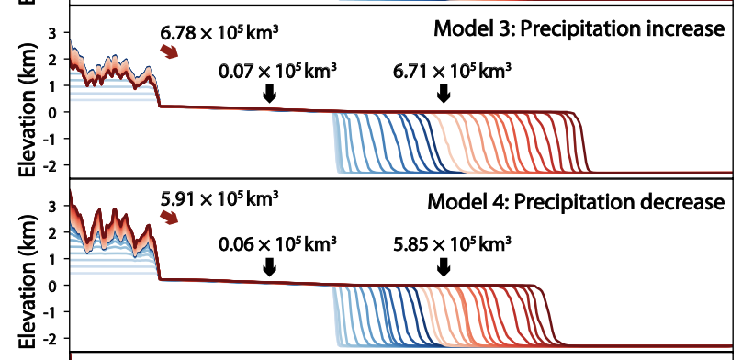
Python in science
Used to image the first black hole…
and the code is available here: https://github.com/achael/eht-imaging
Used in the discovery of gravitational waves
Modelling basin margin progradation in response to climate change
we’ll use this package today
Akiyama, et al. 2019
Zhang, et al. 2018

Slide 6
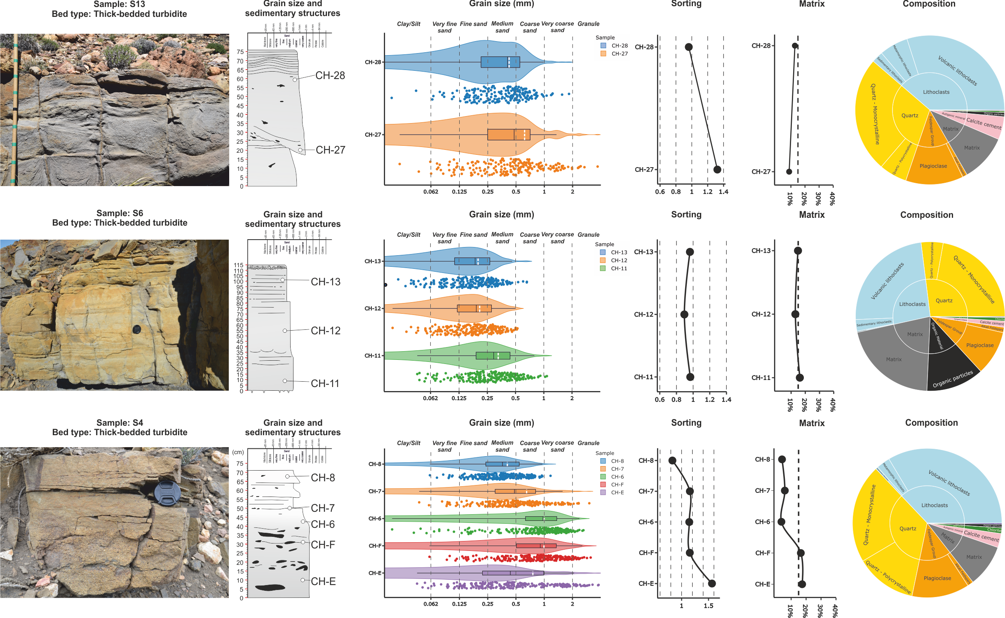
Python in Sedimentology
Where are these figures made?
Martinez-Donate, 2021

Slide 7
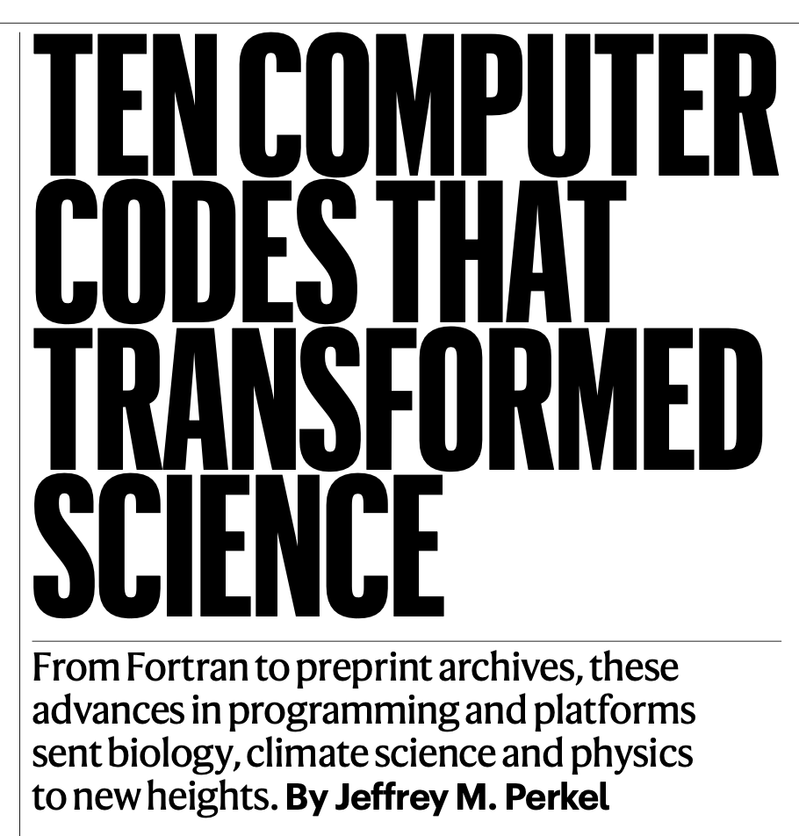
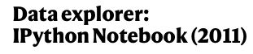

Jupyter Notebooks
Jupyter Notebooks are like an Excel worksheets, but for Python
Often used in science because you can share the notebook easily and add text to your code
10 million notebooks currently on Github
Used to process data that imaged first black hole and discovered gravitational waves
This is what we will use today
Nature, 2021

Slide 8
Tips before we jump in
Don’t be afraid of errors
Don’t be afraid to Google everything, you will forget things
Don’t worry about taking a long time to understand concepts
Just keep practicing and eventually it will click
It’s much easier to practice with your own data e.g. I want to plot this grain size data

Slide 9
Open “Launch Binder” link at:
https://github.com/eslrgs/geo_py

Slide 10




x = ‘hello’ say x
*
In
*
Out
hello

Slide 11

2+2?
*
In
*
Out
4

